Slide 1
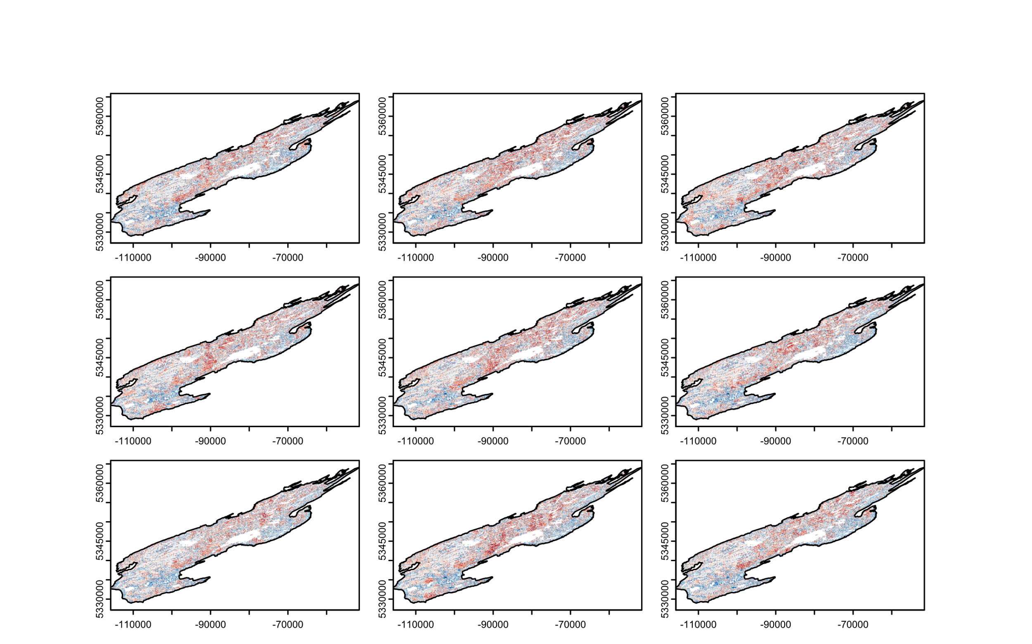
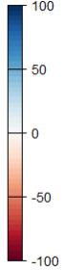
Climate
Low
Hot/Dry
Warm
Hot/Wet
Change in
biomass
density
(Mg ha⁻¹)
Medium
Predation rate
High

